Slide 1

Spark ML For Good: Trump Filtering At Scale
Mike Lanzetta

Slide 2
The Problem

Slide 3
The UN’s Problem
Measuring impact
I coordinate food-related aid to three communities
One of those has their food stolen by warlords
I’m not allowed into the country
I can’t pay people to check – as it would put them in harm’s way

Slide 4
Current Solution
Over-worked agents monitor several regions
Ad-hoc techniques
Look through news sources
Monitor a groomed list of Facebook pages
Follow known people on Twitter
Surveys “on the ground”
Dangerous
Infrequent
Expensive
Notes:
The good news here is that the bar is low. Their existing solution is time consuming and problematic, and even if we have a high false positive rate, if we can focus their limited research time to where it would do the most good, we’ve improved their lives (and the lives of those that depend on them).

Slide 5
Indirect Information
Social media in Libya
WhatsApp
Private Facebook
Social media we can use in Libya
Twitter
Public Facebook
Other (anti-social?) media
RSS feeds
News sites (scraping)
Notes:
We though about going the “direct information” route – giving people that were already going in there an app that would allow them to report from the scene. However, it’s risky, as even an unknown app could trigger suspicion if they were detained by warlords in the area.

Slide 6
Finding and Expanding Relevant Data
Geo-tagged Tweets are Rare in the US
Geo-tagged tweets in Libya
Error: Value is indistinguishable from zero
Location Inference is Possible with Twitter Data
For initial implementation, we used simple location name matching
Twitter Data is Insufficient
Expand using groomed Facebook pages, RSS feeds, potentially Instagram
Built an Ingestion and Processing Pipeline Using Azure Web Apps and Spark

Slide 7
Yes, But What Does It Mean?
Now that we have the data, what can we do with it?
We’ve filtered to location, how about relevance?
How often are people talking about certain key words or phrases?
When they talk about them, how do they feel?
How does that change over time?
Is there a noticeable change after we deploy aid?

Slide 8
Spark To The Rescue

Slide 9
Filtering Tweets
More than Location Filtering Required
Two Real Sample Tweets, see if you can spot the difference:
#1: 53 Dead in Extremist Attack Near Tunisia-Libya Border #Tunisia #Libya https://t.co/y0j2TvqMmT
#2: Hillary said she was in a "Fog of War" as explanation for the lies about Benghazi. No fog allowed in WH. Vote Trump POTUS!
Notes:
You might notice a slight difference between these two.

Slide 10
Trump Filtering as ML
Let’s phrase this as a simple classification problem: Would this tweet get retweeted by @realDonaldTrump?
If so, filter it out
If not, it might actually be news-worthy

Slide 11
A Simple De-Trumpification Classifier
Generating Labeled Data
We can use existing tweets
We can’t afford a “mechanical Turk” effort
So, look for “Benghazi” and “Hillary”
Fringe Benefit: This is our “Null Hypothesis”
One Minor Problem
Since our null hypothesis and our labeling are identical – it performs perfectly
How do we label additional data without spending all of our time looking at tweets?
Solution: Smarter Manual Labeling
Find tweets “near” positive examples, label those appropriately

Slide 12
Featurizing
Many options for featurizing text – how should you decide?
What problem are you trying to solve?
“Trump Retweetability” of sentences
How do you think you might solve it?
Similarity to existing positive examples
Sounds good – look for ways to quantize text into similarity vectors
Word2Vec is exactly that, but just gives you those vectors
TF-IDF seems like a good option, but might not work on Twitter data due to small document size
Since TF-IDF outputs features and Word2Vec outputs matrices that then need to be featurized, in the interests of time we’ll use TF-IDF
As an exercise to the reader – clustering W2V results to group similar looks promising

Slide 13
Results … and are they any good?
I built, trained and evaluated a classifier – how did it do?
But were these results any good in practice?
Remember, the “labels” were a guess based on string matching.
What do some of the “false positives/negatives” look like?
That’s actually pretty great!
# defaultdict(<type 'int'>, {'TN': 122340, 'FP': 3150, 'TP': 27404, 'FN': 4836})
# Precision (0.896904) and Recall (0.850000)
falseVals = posneg.flatMap(lambda x: [ (x[0], x[1]['sentence']) ] if x[0] == 'FP' or x[0] == 'FN' else []).distinct()
for fr in falseVals.take(100):
print fr[0] + ': ' + fr[1]
# FP: news: clinton commits benghazi gaffe, saying us ?didn?t lose a single person? in libya: "liby... https://t.co/ecb2imazjs via @thenewshype
# FP: remember the missing stinger missiles?... remember benghazi? well the pigs are about to fly and the sun is... https://t.co/pcfeujjuko
Notes:
Obviously, more testing would be necessary before deploying this, and you’d want to try and compare it against other classification models. You might also enrich your labeled data by having people manually label the false positives from your simple LR model results.

Slide 14
Measuring Sentiment
Several great tools
Microsoft’s Text Analytics API
Python’s sentiment_classifier
Sentiment140
A few techniques and datasets
“Deeply Moving” (RNNs for sentiment in movie reviews)
SentiWordNet (WordNet with sentiment tags)
Notes:
Now onto the other ML task – measuring sentiment. There are a few tools and datasets out there for this already…

Slide 15

Measuring Sentiment In Arabic
Notes:
…but none of them currently works with Arabic tweets. My email is at the end of the presentation – please prove me wrong and email ones that do.

Slide 16

The Problem With Sentiment
An MIT linguistics professor was lecturing his class the other day.
"In English," he said, "a double negative forms a positive. However, in some languages, such as Russian, a double negative remains a negative. But there isn't a single language, not one, in which a double positive can express a negative."
A voice from the back of the room piped up, "Yeah, right."
Sentiment based on single words alone is difficult, you need to take context and language into account.

Slide 17
Sentiment Analysis Options in Python
sentiment_classifier
Based on SentiWordNet
Easy to install and use
Free as in beer
GPL License
Microsoft Text Analytics
REST-based API
Supports Batching
Cheap Pay-Per-Use Model
Roll Your Own
Some publicly available data exists
Even more free
Performance is … :-S

Slide 18
Building a Sentiment Analyzer
What Training Data?
SentiWordNet is easy to use, but is word-based and English
We could accumulate scores for the words within tweets from this list
Binary Classifier? Or Regressor? Or Multiple Regressor (pos/neg)?
Training data has positive and negative scores – let’s go with that
Dealing With Arabic
Translate SentiWordNet words and use those
Dealing With Twitter
#SuperPainful ☹ (word-break hashtags, amend SentiWordNet with emoji)

Slide 19
The Solution

Slide 20
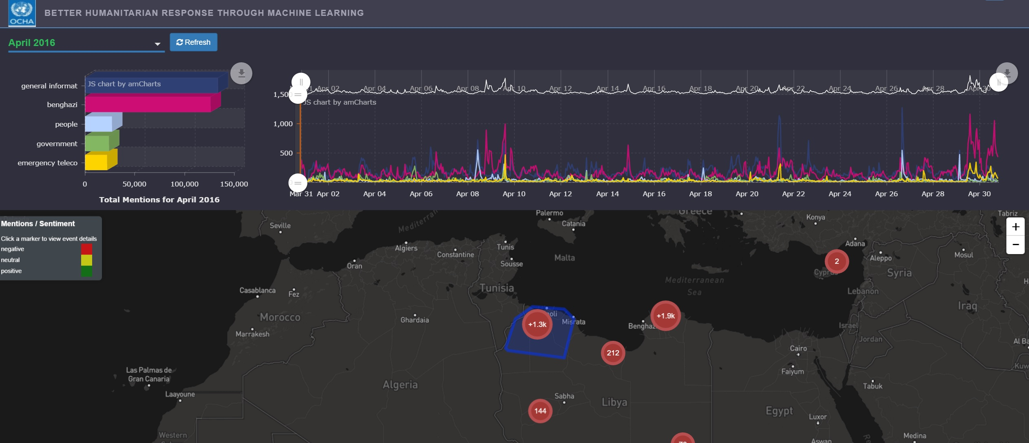
United Nations
Notes:
This is a shot of the dashboard in action, with all contents of the heatmap and graphs populated by various Spark jobs.

Slide 21
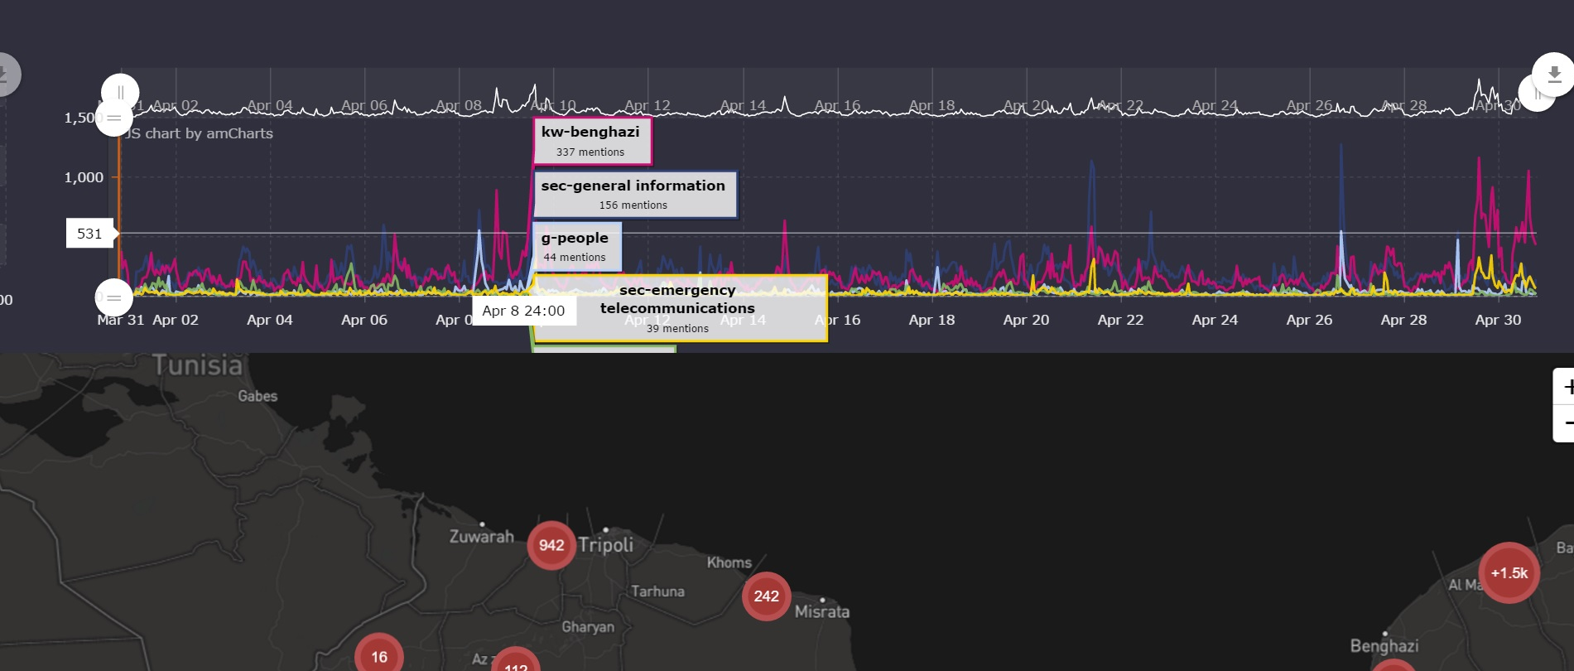

Slide 22
Closing Notes
Real-world examples help highlight how much work goes into cleansing and featurization
We’ve only scratched the surface of SparkML’s offerings
Many more regression and classification algos available
Cross-validation for meta-parameter tuning
Spark can perform well, but it takes work
RDD/DF.persist() is important
Watch out for keyspace skew
Watch out for file size (many small files is worse than fewer large ones)

Slide 23
Additional Resources
Spark:
Spark itself: https://spark.apache.org/docs/latest/index.html
Spark ML and MLLib: https://spark.apache.org/docs/latest/mllib-guide.html
Spark on Azure: https://azure.microsoft.com/en-us/documentation/articles/hdinsight-apache-spark-zeppelin-notebook-jupyter-spark-sql/
Contact Us:
Email: milanz@microsoft.com
Twitter: @noodlefrenzy
Code from this talk: https://github.com/noodlefrenzy/SparkForGood

Slide 24
Q&A

